Slide 1
Genetic Algorithm: Assignments

Slide 2
Problem 1. Maintenance scheduling
Maintenance scheduling problems are usually solved using a combination of search techniques and heuristics.
These problems are complex and difficult to solve.
They are NP-complete and cannot be solved by combinatorial search techniques.
Scheduling involves competition for limited resources, and is complicated by a great number of badly formalised constraints.

Slide 3
Case study
Scheduling of 7 units in 4 equal intervals
The problem constraints:
The maximum loads expected during four intervals are 80, 90, 65 and 70 MW;
Maintenance of any unit starts at the beginning of an interval and finishes at the end of the same or adjacent interval. The maintenance cannot be aborted or finished earlier than scheduled;
The net reserve of the power system must be greater or equal to zero at any interval.
The optimum criterion is the maximum of the net reserve at any maintenance period.

Slide 4
Performance graphs and the best maintenance schedules created in a population of 20 chromosomes
F i t n e s s
M W
(a) 50 generations

Slide 5
Performance graphs and the best maintenance schedules created in a population of 20 chromosomes
F i t n e s s
(b) 100 generations

Slide 6
Performance graphs and the best maintenance schedules created in a population of 100 chromosomes
F i t n e s s
(a) Mutation rate is 0.001

Slide 7
Performance graphs and the best maintenance schedules created in a population of 100 chromosomes
F i t n e s s
(b) Mutation rate is 0.01

Slide 8

Problem 2: n-queens
Put n queens on an n × n board with no two queens on the same row, column, or diagonal

Slide 9
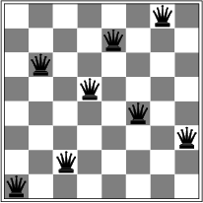
8-queens problem
Please define the encode method and the fitness function for GA

Slide 10
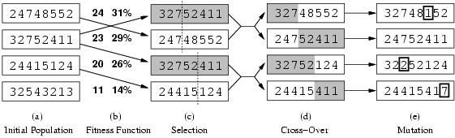
Genetic algorithms
Fitness function: number of non-attacking pairs of queens (min = 0, max = 8 × 7/2 = 28)
24/(24+23+20+11) = 31%
23/(24+23+20+11) = 29% etc

Slide 11
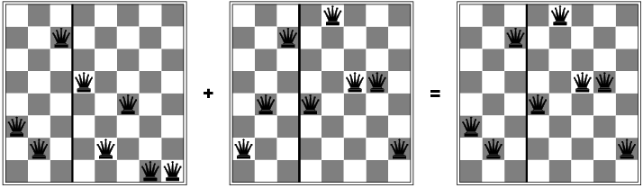
Genetic algorithms

